Slide 1

7th Grade Math
Unit 4, Lesson 4 Finding the Area of Composite Figures Volume 1, pg. 142

Slide 2


Benchmark
MA.7.GR.1.2
Solve mathematical or real–world problems involving the areas of polygons or composite figures by decomposing them into triangles or quadrilaterals.
volume 1, pg. 142

Slide 3
Integrated Mathematical Thinking and Reasoning Standards
MA.K12.MTR.1.1 Actively participate in effortful learning both individually and collectively.
MA.K12.MTR.2.1 Demonstrate understanding by representing problems in multiple ways.
MA.K12.MTR.4.1 Engage in discussions that reflect on the mathematical thinking of self and others.
MA.K12.MTR.5.1 Use patterns and structure to help understand and connect mathematical concepts.
volume 1, pg. 142

Slide 4

Learning Target
I can decompose composite figures into triangles and quadrilaterals to find the area.
volume 1, pg. 142

Slide 5

Warm-Up
volume 1, pg. 143

Slide 6

4.4.1 Warm-Up: Math Fail
The advertisement below is for the sale of colored strands for braids to raise money for a Stop Drug Abuse campaign.
Explain what the math fail is in the advertisement.
volume 1, pg. 143
Notes:
Video Link: https://algebranation.wistia.com/medias/fi4fidi5y8

Slide 7

Guided Instruction
volume 1, pg. 143

Slide 8

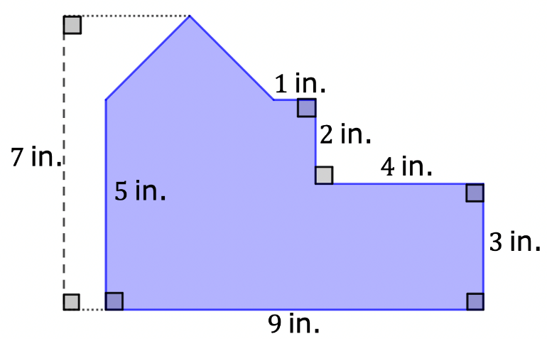
4.4.2 Guided Instruction: Finding the Area of Polygons
Composite figures are two- or three-dimensional figures that can be decomposed into smaller figures.
A floorplan is shown. All segment lengths are in inches (in.).
volume 1, pg. 143

Slide 9
With your partner, decompose the floorplan into triangles and quadrilaterals.
Find the area of the floorplan. Show your work.
volume 1, pg. 143

Slide 10
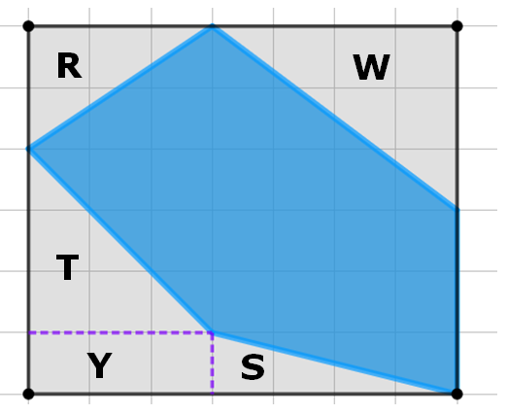
A polygon inscribed inside a rectangle is shown on the grid. Each grid line is 1 unit.
Complete the table.
Polygon Inscribed in a Rectangle
volume 1, pg. 144

Slide 11
Decomposition of Rectangle
Area of the large rectangle
Area of R
Area of S
Area of T
Area of W
Area of Y
Area of the blue polygon
volume 1, pg. 144

Slide 12
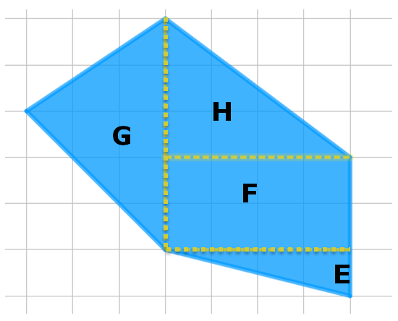
The same polygon is shown on the grid. Each grid line is $1$ unit.
Polygon
volume 1, pg. 144

Slide 13
Decomposition of Rectangle
Area of the large rectangle
Area of E
Area of F
Area of G
Area of H
Area of the blue polygon
Discuss with your partner the different possible methods of finding the area of the blue polygon. List one strength of each method.
volume 1, pg. 144

Slide 14

Collaboration
volume 1, pg. 145

Slide 15

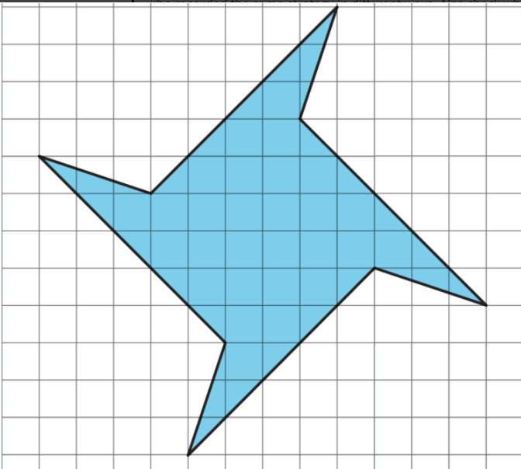
4.4.3 Collaboration: Area of a Polygon
A polygon is shown on grid paper. Each grid line is $1$ unit.
volume 1, pg. 145

Slide 16
Decompose the polygon into triangles and quadrilaterals.
Share your decomposition with your partner. List at least one similarity and one difference.
volume 1, pg. 145

Slide 17
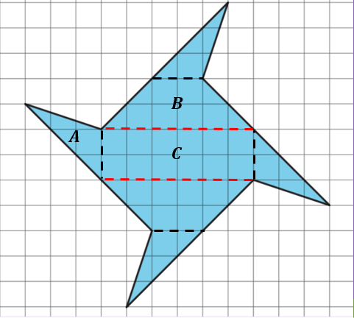
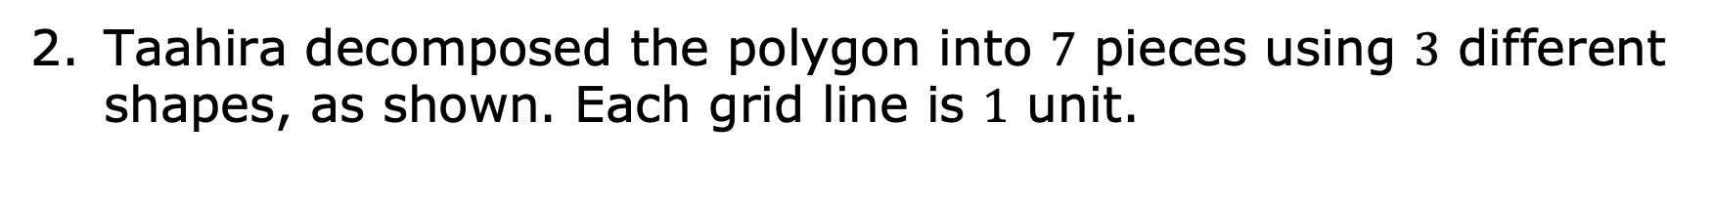
Taahira decomposed the polygon into $7$ pieces using $3$ different shapes, as shown. Each grid line is $1$ unit.
volume 1, pg. 145

Slide 18
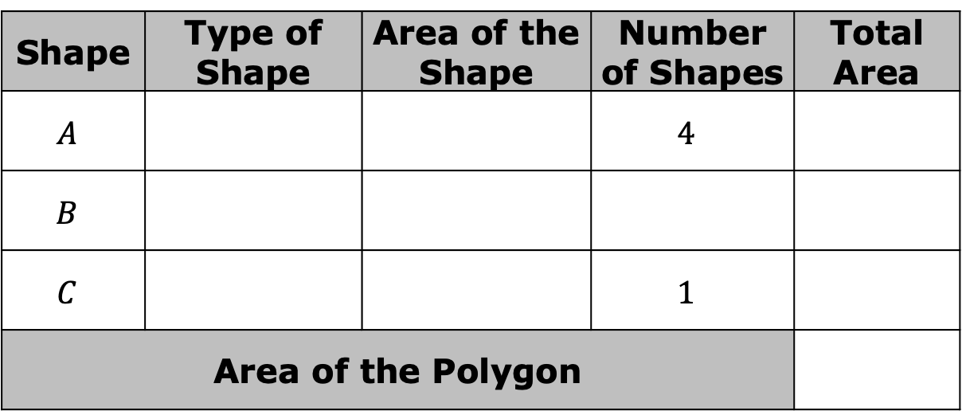
Work with your partner to find the area of each shape and the total area of the polygon.
Shape | Type of Shape | Area of the Shape | Number of Shapes | Total Area
$$A$$ |  |  | $$4$$
$$B$$
$$C$$ |  |  | $$1$$
Area of the Polygon
volume 1, pg. 145

Slide 19

Guided Practice
volume 1, pg. 146

Slide 20

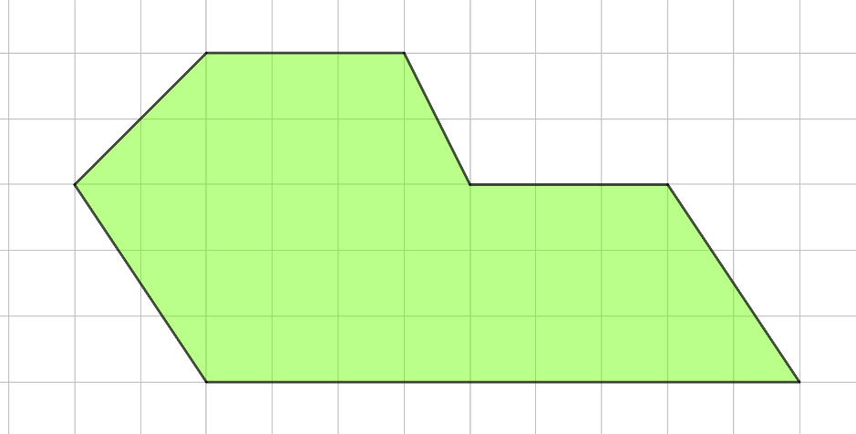
4.4.4 Guided Practice: Decomposing Composite Figures to Find Area
A polygon is shown on a grid. Each grid line is $1$ unit.
Find the area of the polygon.
volume 1, pg. 146

Slide 21
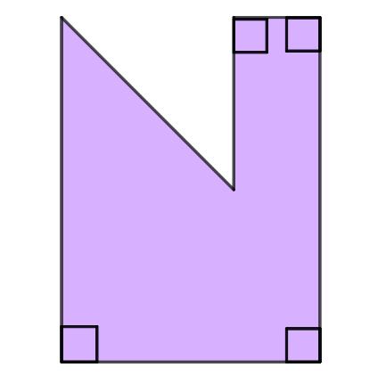




A polygon is shown with the given measurements in meters (m).
$1$ m
$2$ m
$4$ m
$3$ m
What is the area of the composite figure?
volume 1, pg. 146

Slide 22

Your Turn
volume 1, pg. 147

Slide 23
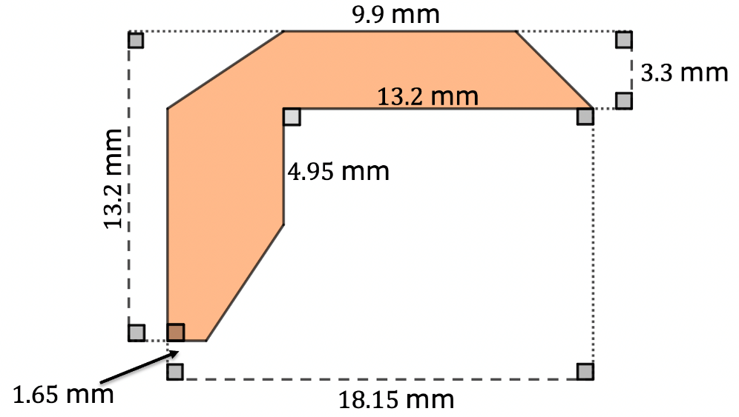
4.4.5 Your Turn!
Find the area of the polygon. Lengths are shown in millimeters (mm).
volume 1, pg. 147

Slide 24

Wrap-Up
volume 1, pg. 147

Slide 25

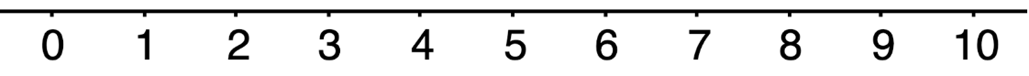
4.4.6 Wrap-Up: Reflection
Place an X on the number in the emoji scale that indicates your understanding in relation to today’s learning target.
I can decompose composite figures into triangles and quadrilaterals to find the area.
volume 1, pg. 147

Slide 26
Provide evidence to explain your self-assessment.
volume 1, pg. 147

